Slide 1
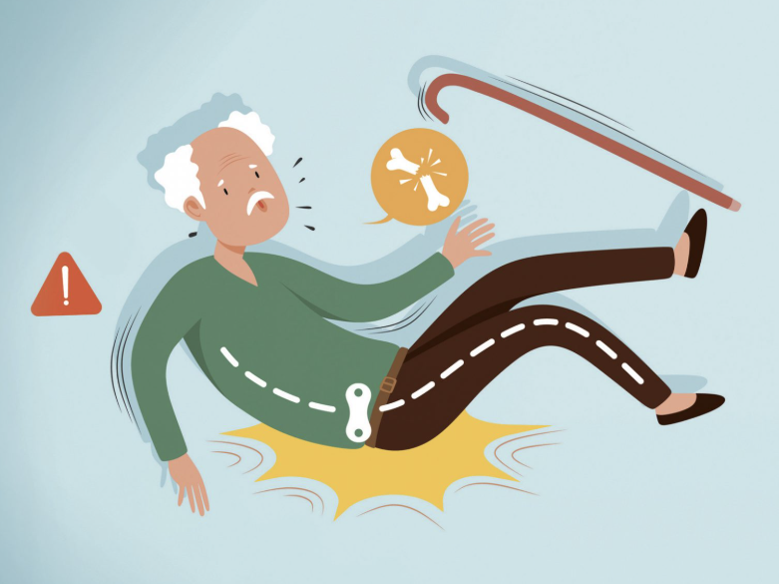
Needs Statement:
A way to address delayed emergency response in elderly individuals who fall without immediate detection that reduces time-to-help, preventing deaths from bleeding,
hypothermia, and dehydration.
Approximately 14 million Americans over the age of 65 experience a fall annually [1].
One in eight older individuals who fell have reported lying on the floor for over an hour [2]
In 2015, the U.S. spent an estimated $50 billion in medical costs pertaining to both fatal and nonfatal falls, with this expected to increase as the population continues to age [3].
By the year 2030, the U.S.’ senior care technologies market is projected to reach $43.86 billion; an increasing market and opportunity for adoption [4].
[5]

Slide 2
References
[1] Centers for Disease Control and Prevention, “Older adult falls data,” Older Adult Fall Prevention, Oct. 28, 2024. https://www.cdc.gov/falls/data-research/index.html
[2] J. Kubitza, M. Haas, L. Keppeler, and B. Reuschenbach, “Therapy options for those affected by a long lie after a fall: A scoping review,” BMC geriatrics, https://pmc.ncbi.nlm.nih.gov/articles/PMC9284880/ (accessed Oct. 6, 2025).
[3] C. S. Florence, G. Bergen, A. Atherly, E. Burns, J. Stevens, and C. Drake, “Medical Costs of Fatal and Nonfatal Falls in Older Adults,” Journal of the American Geriatrics Society, vol. 66, no. 4, pp. 693–698, Mar. 2019, doi: https://doi.org/10.1111/jgs.15304.
[4] R. and, “Senior Care Technologies Market - Forecasts from 2025 to 2030,” Researchandmarkets.com, 2025. https://www.researchandmarkets.com/reports/5926867/senior-care-technologies-market-forecasts?srsltid=AfmBOoqjPL22tO8ABvKK583hOHbJpyJJWzrhCc8Qv2LZ5BrxN4LKXYRh (accessed Oct. 07, 2025).
[5] rehabmagazine, “Connecting the fall prevention dots with Loop - Rehab & Community Care Medicine Magazine,” Rehab & Community Care Medicine Magazine, Dec. 12, 2023. https://www.rehabmagazine.ca/connecting-the-fall-prevention-dots-with-loop/ (accessed Oct. 07, 2025).

